Slide 1
The Power of Persuasion Modeling
Michelangelo D’Agostino
Director of Data Science R&D
mdagostino@civisanalytics.com
@MichelangeloDA
Bill Lattner
Senior Data Scientist
wlattner@civisanalytics.com
@wlattner

Slide 2

The Power of Persuasion Modeling
Introduction to persuasion modeling
response modeling vs. persuasion modeling
a note on nomenclature
Notes:
https://pixabay.com/en/angry-debate-emotion-fist-hand-1294679/

Slide 3
The Power of Persuasion Modeling
Introduction to persuasion modeling
response modeling vs. persuasion modeling
a note on nomenclature
Persuasion modeling methods
Evaluating persuasion models

Slide 4
The Power of Persuasion Modeling
Introduction to persuasion modeling
response modeling vs. persuasion modeling
a note on nomenclature
Persuasion modeling methods
Evaluating persuasion models
Real-world case studies
TV promotional ad effectiveness for the Bravo network
persuasion in the 2016 election cycle
TV promotional ad effectiveness from observational data

Slide 5
Motivation
Many applications across various domains have a similar form. We want to design and target an intervention to maximize some outcome:
Marketing: maximize the return-on-investment of a particular advertising campaign or offer
Website or App: maximize user engagement or click-through-rate
Medicine: maximize “quality adjusted life years” (QALY’s) through medical interventions
Politics: maximize votes by designing the most persuasive messaging to those on the fence

Slide 6

Response Modeling
One common approach to these problems is to target the people most likely to respond to your campaign, offer, or intervention.
Machine Learning
Ranked List of Targets Most Likely to Respond
CRM Data
Ad Campaign
Notes:
http://www.publicdomainpictures.net/view-image.php?image=118398&picture=retro-tv
A common approach to this set of problems is response modeling or lookalike modeling

Slide 7
Lookalike Modeling
Find patterns within the client data
Model
And start with a smaller list of client data
Customer List
Make a list of individuals with the highest scores
List
1
2
3
4
5
6
7
Population
Start with a large database of people
Match
Append additional variables to the client data by matching back to population database
Score
Based on these patterns, give each person in the database a score indicating their likelihood to “look like” the customer list
Contact
Reach out to the population that “looks like” the original customer list
Notes:
In applications like new user acquisition, another common approach is to target the people who look most like your current customers.

Slide 8

But the key question: How do we know that we’re actually adding incremental sales/users/votes and not just finding the people who would have used us or supported us anyway?
Notes:
https://commons.wikimedia.org/wiki/File:The_Thinker_Musee_Rodin.jpg

Slide 9
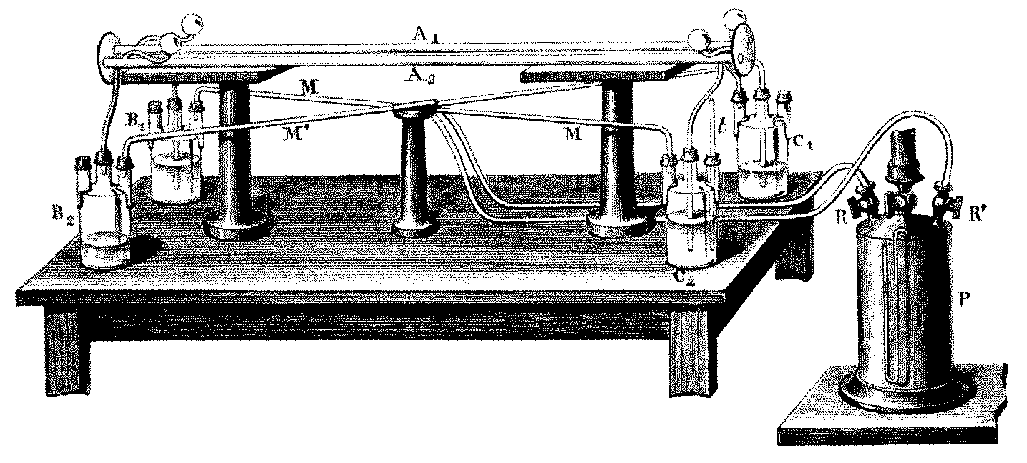
Let’s run a thought experiment to evaluate purchase rates between our targets and non-targets.
Notes:
https://commons.wikimedia.org/wiki/File:Fizeau-Mascart2.png
We’ve actually run this experiment for clients before, so it’s not totally made up.

Slide 10
Ad
High Purchase Model Scores
No Ad
Customers
Ad
Low Purchase Model Scores
No Ad

Slide 11
Observed
Purchase Rate
Ad
3.1%
High Purchase Model Scores
No Ad
3.0%
Customers
Ad
0.7%
Low Purchase Model Scores
No Ad
0.3%

Slide 12
Users with a higher predicted purchase score are indeed more likely to respond to the offer than those with lower purchase scores…
Observed
Purchase Rate
Ad
3.1%
High Purchase Model Scores
No Ad
3.0%
Customers
Ad
0.7%
Low Purchase Model Scores
No Ad
0.3%

Slide 13
…but the ad has very little incremental effect on those with high scores, who would have purchased at basically the same rate without seeing the ad.
Observed
Purchase Rate
Ad
3.1%
High Purchase Model Scores
No Ad
3.0%
Customers
Ad
0.7%
Low Purchase Model Scores
No Ad
0.3%

Slide 14
However, the ad does seem to have a high incremental effect among those who weren’t already likely to buy.
Observed
Purchase Rate
Ad
3.1%
High Purchase Model Scores
No Ad
3.0%
Customers
Ad
0.7%
Low Purchase Model Scores
No Ad
0.3%

Slide 15
However, the ad does seem to have a high incremental effect among those who weren’t already likely to buy.
Observed
Purchase Rate
Ad
3.1%
High Purchase Model Scores
How do we target the people most likely to respond because of the ad and not just people who were likely to respond anyway?
No Ad
3.0%
Customers
Ad
0.7%
Low Purchase Model Scores
No Ad
0.3%

Slide 16
Persuasion Modeling
Persuasion modeling can overcome some of these shortcomings with response and lookalike modeling.
Persuasion modeling starts with a randomized controlled experiment and tries to identify the subsets of people that are most likely to respond to the treatment, offer, or message—not just the people who are most likely to respond anyway.
If done well, persuasion modeling can beat response and lookalike modeling for driving incremental actions.

Slide 17
It All Starts With an Experiment…
Control Group
Nothing
Survey or Behavioral Outcome
Customers
Treatment Group I
Promo #1
Treatment Group II
Promo #2
•
•
•
•
•
•
Notes:
Note: we can select our initial universe however we want before doing the treatment/control split. In the TV context we’ll talk about later, we could subset only to people who are aware of your network or program or brand.
In the following, we’ll simplify to just assume that we have one treatment/promo and one control.

Slide 18
Randomized Controlled Experiments
purchased? | promotion? | age | state | income
yes | yes | 65 | WI | $$
no | yes | 43 | OH | $
no | no | 44 | OH | $$

Slide 19
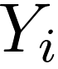
Randomized Controlled Experiments
purchased? | promotion? | age | state | income
yes | yes | 65 | WI | $$
no | yes | 43 | OH | $
no | no | 44 | OH | $$
our outcome of interest for the i^{th} person

Slide 20
Randomized Controlled Experiments
purchased? | promotion? | age | state | income
yes | yes | 65 | WI | $$
no | yes | 43 | OH | $
no | no | 44 | OH | $$
our treatment indicator variable, which often takes the values 0 for control and 1 for treatment

Slide 21
Randomized Controlled Experiments
purchased? | promotion? | age | state | income
yes | yes | 65 | WI | $$
no | yes | 43 | OH | $
no | no | 44 | OH | $$
other covariates that describe each person in our experiment

Slide 22
Randomized Controlled Experiments
purchased? | promotion? | age | state | income
yes | yes | 65 | WI | $$
no | yes | 43 | OH | $
no | no | 44 | OH | $$
We can calculate the overall effectiveness of the promotion from this data. We typically call this the ATE (average treatment effect):

Slide 23
HTE - ATE’s Evil Extension
The ATE is useful: it allows us to compare different treatments and promotions for overall effectiveness.
BUT, it is a population average. It is entirely possible to have a negative ATE overall, but for some subpopulations to have a positive treatment effect. In allocating promotional efforts, we would like to identify these heterogeneous treatment effects—groups that benefit more from the treatment than others.
Notes:
Now remember:

Slide 24
HTE - ATE’s Evil Extension
The ATE is useful: it allows us to compare different treatments and promotions for overall effectiveness.
BUT, it is a population average. It is entirely possible to have a negative ATE overall, but for some subpopulations to have a positive treatment effect. In allocating promotional efforts, we would like to identify these heterogeneous treatment effects—groups that benefit more from the treatment than others.
First, some extra notation:
outcome for the i-th person if they were in the control group
outcome for the i-th person if they were in the treatment group
Notes:
Now remember: WE ONLY OBSERVE ONE OF THESE THINGS FOR EACH PERSON, BECAUSE THEY ARE EITHER IN THE TREATMENT GROUP OR THE CONTROL GROUP. WE CAN’T DIRECTLY OBSERVER WHAT WOULD HAVE HAPPENED HAD EACH PERSON BEEN IN THE OTHER GROUP. BUT LET’S FORGET THAT FOR A SECOND…

Slide 25
HTE - ATE’s Evil Extension
The ATE is useful: it allows us to compare different treatments and promotions for overall effectiveness.
BUT, it is a population average. It is entirely possible to have a negative ATE overall, but for some subpopulations to have a positive treatment effect. In allocating promotional efforts, we would like to identify these heterogeneous treatment effects—groups that benefit more from the treatment than others.
First, some extra notation:
individual-level treatment effect:
outcome for the i-th person if they were in the control group
outcome for the i-th person if they were in the treatment group
Notes:
IF WE HAD THAT INFORMATION, THIS IS WHAT WE’D DO. FOR EACH PERSON, WE CALCULATE THE DIFFERENCE BETWEEN WHAT WOULD HAPPEN IF THEY GOT THE TREATMENT AND IF THEY DIDN’T.

Slide 26
The Rubin Causal Model
Y(1) | Y(0) | promotion? | age | state | income
yes | ? | yes | 65 | WI | $$
yes | ? | yes | 43 | OH | $
? | no | no | 44 | OH | $$
We only observe the values in blue, but we need both and to estimate the treatment effect for each person.
TL;DR? It’s a missing data problem, and we can do imputation with a predictive model. The model can learn about what would have happened to a treated person by looking at similar controlled people.
Notes:
THE KEY IDEA IS THAT, BECAUSE OF RANDOMIZATION, THERE IS A PERSON IN THE CONTROL GROUP SIMILAR TO EACH PERSON IN THE TREATMENT GROUP, SO YOU CAN COMPARE THOSE PEOPLE.

Slide 27
A Note on Terminology
The literature on this type of modeling is spread across many domains. Keep an eye out for the following:
persuasion modeling: political science and politics
heterogeneous treatment effects modeling (HTE): economics and social science
heterogeneous causal effects: economics and social science
uplift modeling or net lift modeling: marketing literature
Note: as a problem domain, this type of modeling is not very commonly discussed in the machine learning and data science communities. But we think it should be!

Slide 28
Persuasion Modeling Methods

Slide 29
A Very Simple Linear Model

Slide 30
A Very Simple Linear Model
Treatment Indicator

Slide 31
A Very Simple Linear Model
Other Covariates

Slide 32
A Very Simple Linear Model
Main Effects
Notes:
The main effects capture the ATE, which is the same for everybody, through the first term, and the effect of the various covariates on the base rate (income, gender, etc.)

Slide 33
A Very Simple Linear Model
Interactions
Notes:
The interaction terms allow the treatment effect to vary with the covariates.

Slide 34
A Very Simple Linear Model
Estimated outcome if person i was in the control group

Slide 35
A Very Simple Linear Model
Estimated outcome if person i was in the treatment group

Slide 36
A Very Simple Linear Model
Estimated treatment effect for person i

Slide 37
A More Advanced Model: Causal Trees
Athey and Imbens, arxiv:1504.01132v3
treatment
control
A CART-like or random forest-like algorithm but with an altered split criterion for estimating heterogeneous treatment effects
leaf a
leaf b
leaf c
leaf d
Notes:
Mention that vanilla GBT and RF models with treatment indicators thrown in can work, as well as differently regularized LASSO models. But here we’ll just focus on this one example type.

Slide 38
A More Advanced Model: Causal Trees
Athey and Imbens, arxiv:1504.01132v3
treatment
control
A CART-like or random forest-like algorithm but with an altered split criterion for estimating heterogeneous treatment effects
Choose the split variables and split points from the observable covariates to maximize
leaf a
leaf b
leaf c
leaf d
Notes:
Mention that vanilla GBT and RF models with treatment indicators thrown in can work, as well as differently regularized LASSO models. But here we’ll just focus on this one example type.

Slide 39
A More Advanced Model: Causal Trees
Athey and Imbens, arxiv:1504.01132v3
treatment
control
A CART-like or random forest-like algorithm but with an altered split criterion for estimating heterogeneous treatment effects
Choose the split variables and split points from the observable covariates to maximize
where
leaf a
leaf b
leaf c
leaf d
Notes:
Mention that vanilla GBT and RF models with treatment indicators thrown in can work, as well as differently regularized LASSO models. But here we’ll just focus on this one example type.

Slide 40
A More Advanced Model: Causal Trees
Athey and Imbens, arxiv:1504.01132v3
treatment
control
A CART-like or random forest-like algorithm but with an altered split criterion for estimating heterogeneous treatment effects
Choose the split variables and split points from the observable covariates to maximize
where
leaf a
leaf b
leaf c
leaf d
Notes:
Mention that vanilla GBT and RF models with treatment indicators thrown in can work, as well as differently regularized LASSO models. But here we’ll just focus on this one example type.

Slide 41
Persuasion Model Evaluation

Slide 42
Model Evaluation and Selection
How do we know if our model is doing a good job?
Can we design robust checks like we have for regular supervised learning to tell us if our model is working well and to help us choose between different types of models?

Slide 43
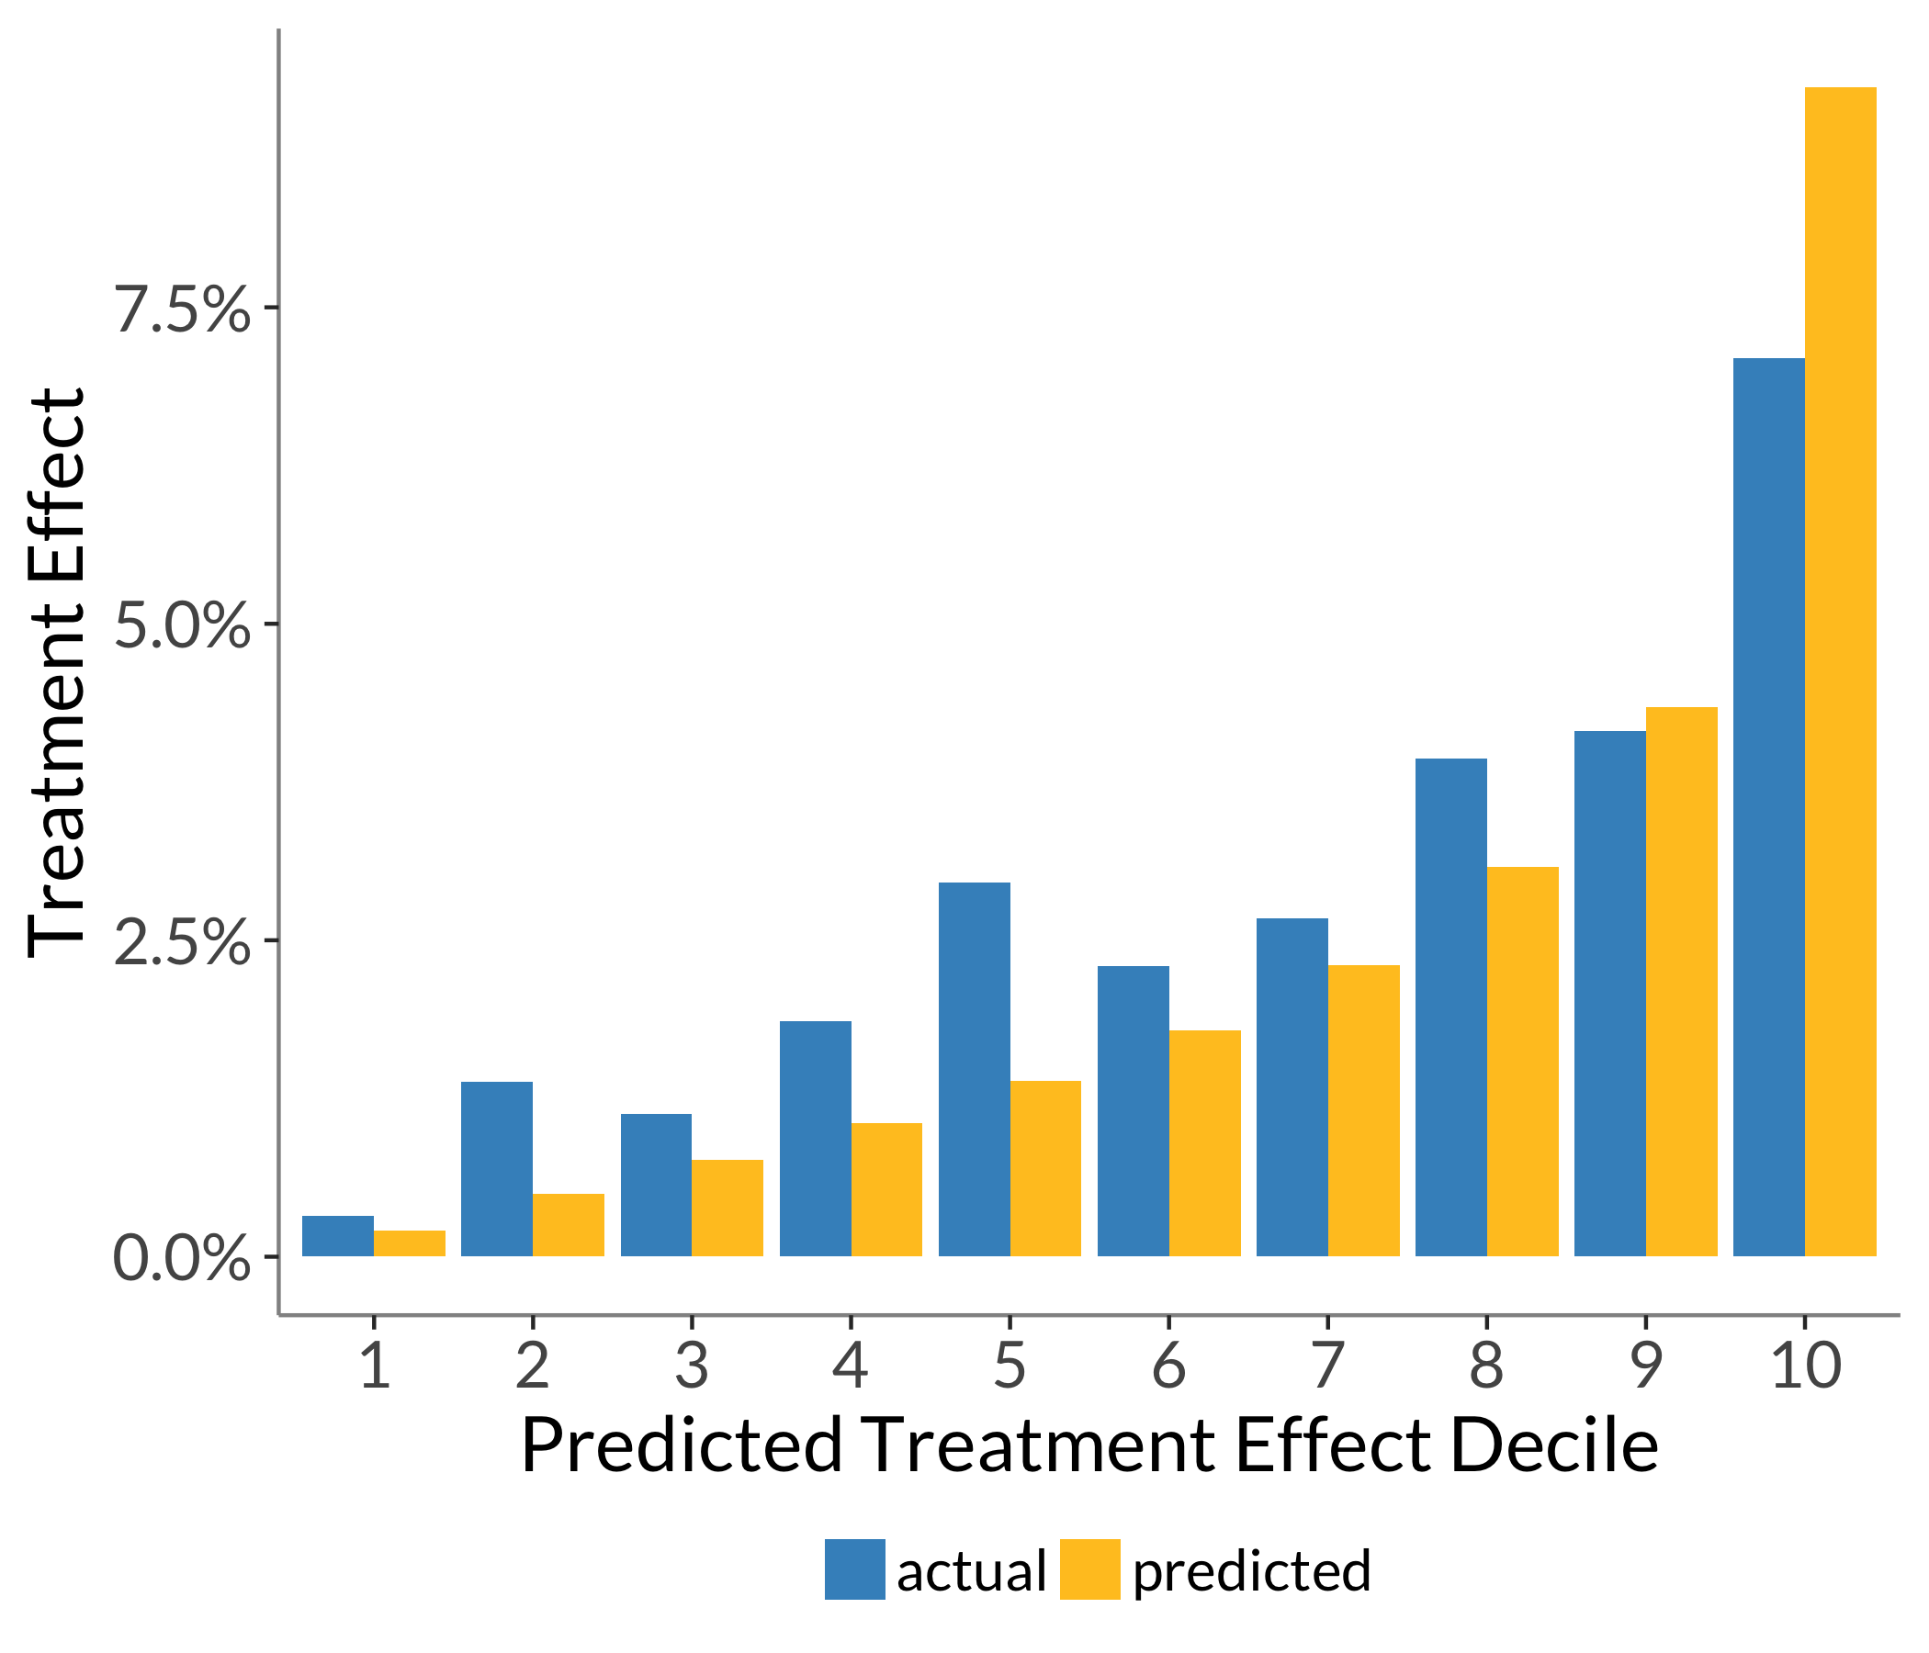
Model Evaluation and Selection
Using a holdout set or cross-validation, get a set of out-of-sample treatment effect scores from a given model.
Quantile those scores and calculate the true ATE within each quantile.
Check that those predictions order well and see how they compare to the average predictions in each quantile.

Slide 44
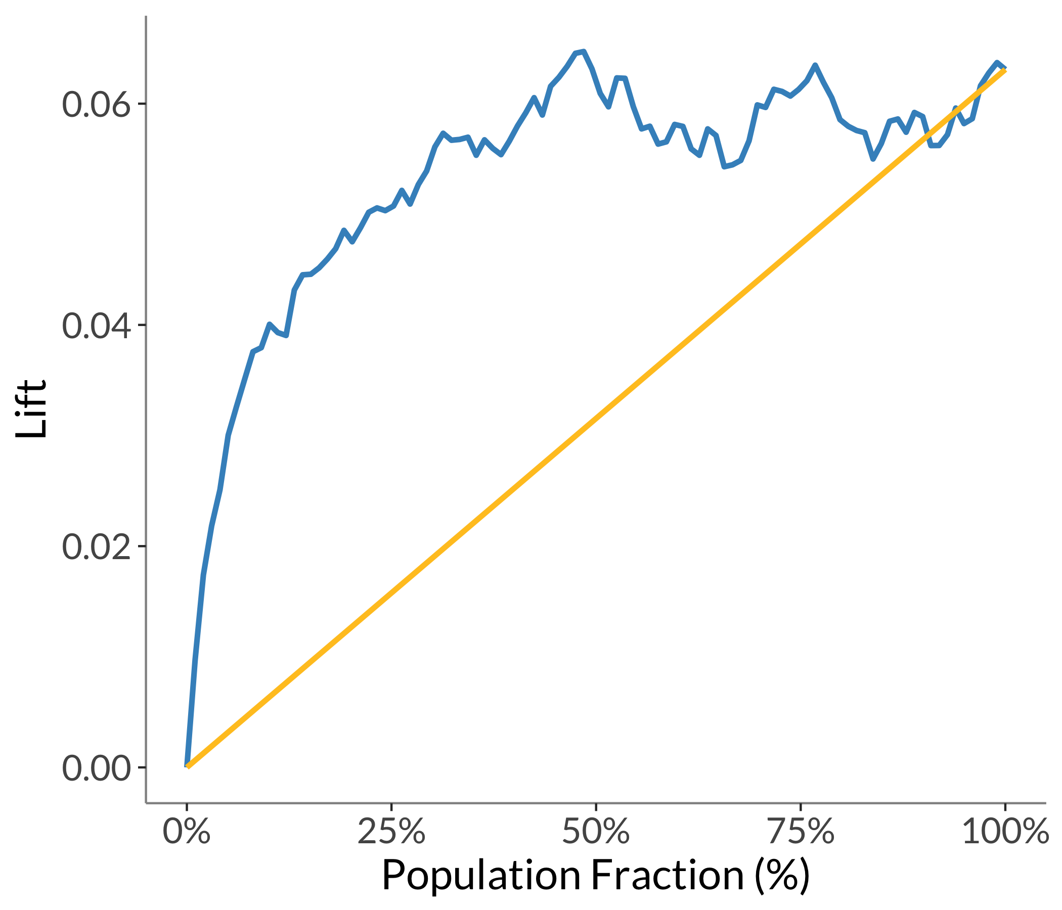
Model Evaluation and Selection
The uplift curve represents the incremental gain from using the model to target effort or outreach.
Similar to the quantile plot, rank observations by predicted ATE and compare to actual ATE in each group, blue line.
Compare this to randomly ordering observations, yellow line.

Slide 45
Model Evaluation and Selection
The uplift curve represents the incremental gain from using the model to target effort or outreach.
Similar to the quantile plot, rank observations by predicted ATE and compare to actual ATE in each group, blue line.
Compare this to randomly ordering observations, yellow line.
6.5% gain from targeting top 50% of scores
vs 2.5% from randomly targeting same number of people

Slide 46
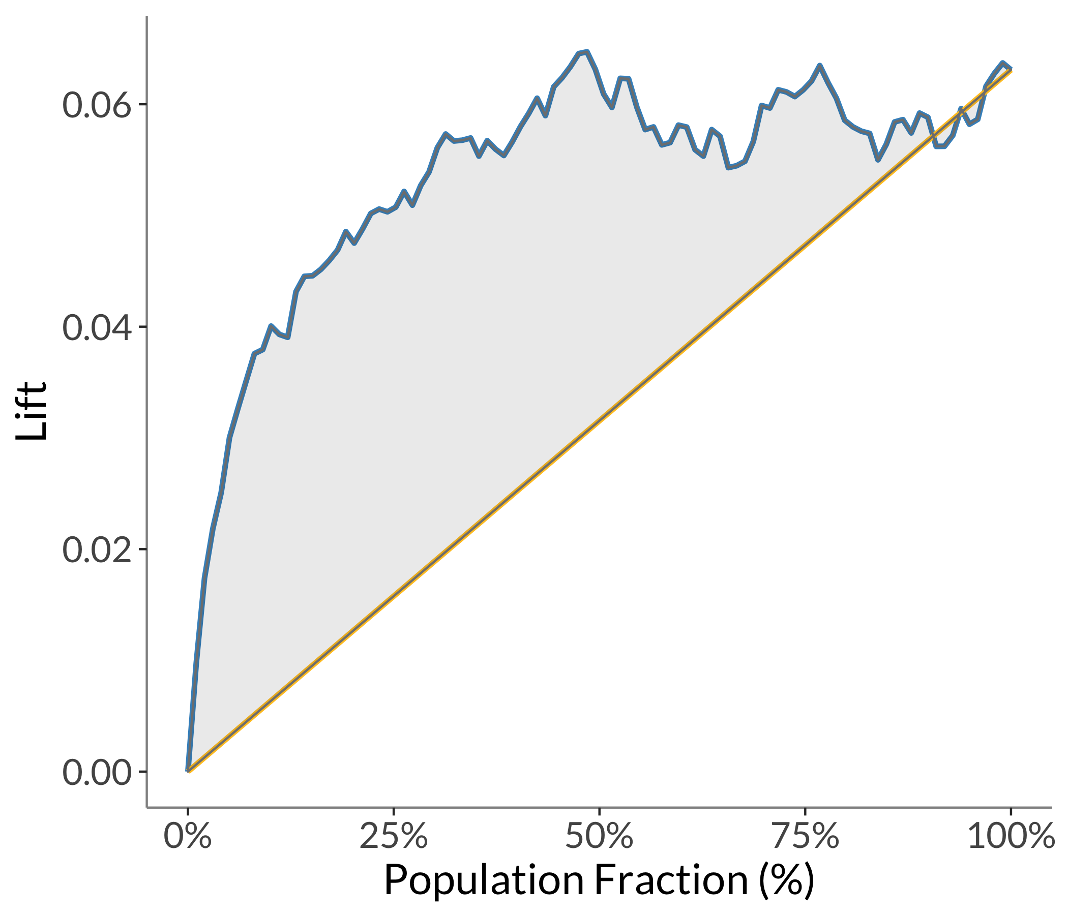
Model Evaluation and Selection
The qini coefficient is analogous to the area under the ROC curve (AUC) for supervised learning.
A single metric we can use to compare models fit to the same task.
Scale matters, so we can’t use to compare models in absolute terms.

Slide 47
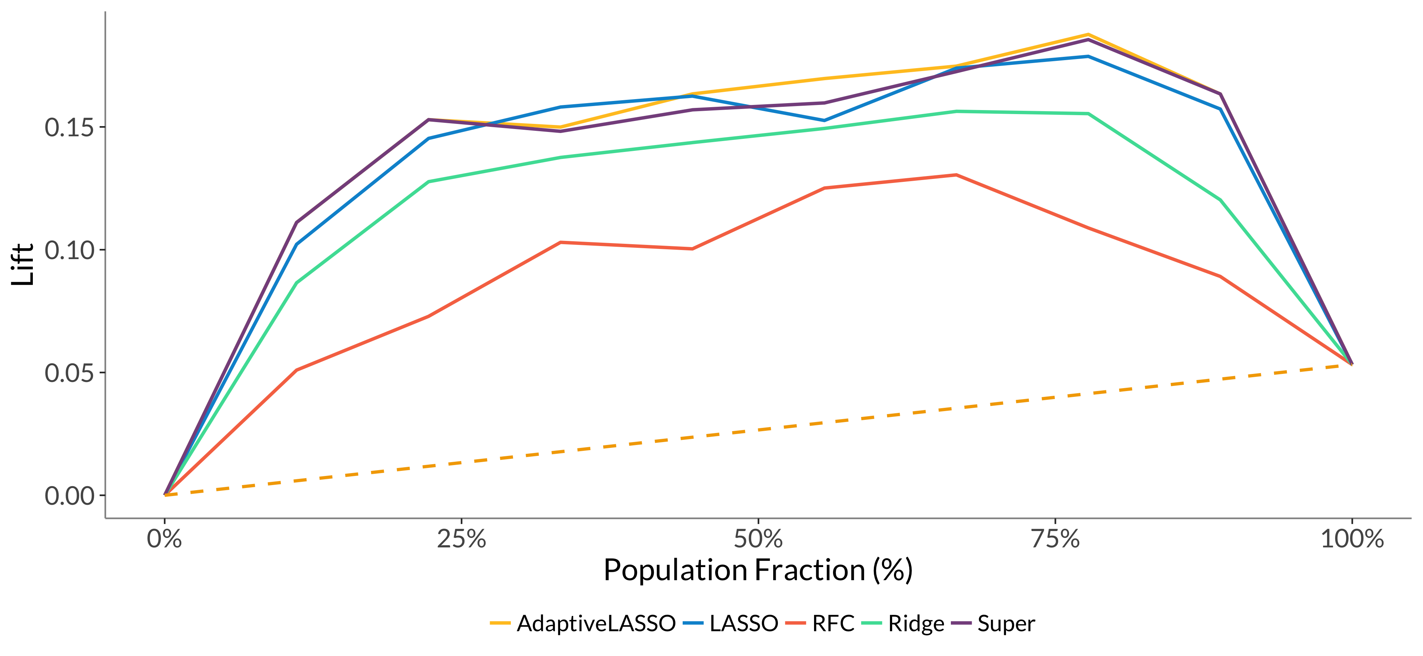
Model Evaluation and Selection

Slide 48
How We Use Persuasion Modeling at Civis

Slide 49
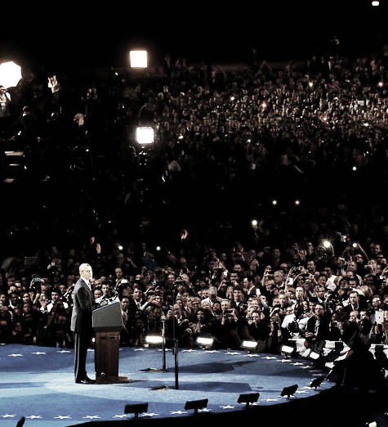

We ran the first individualized presidential campaign.
agenda
We built a scientific understanding of each voter.
Our data science targeted voters through paid media, direct mail, social media, communications and fundraising.
Our data science directed decision makers’ strategies and tactics.
Civis Analytics

Slide 50
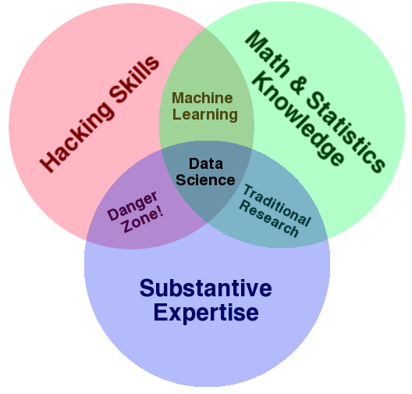
Econometrics
Social Science Methodology
Traditional Social Science Research
Notes:
Because of our unique heritage, we have a lot of different backgrounds on our data, data science, and client facing teams. (political science, economics, survey research, the hard sciences, math/stats)
And as a company, we sit at this sweet spot of the traditional venn diagram of data science with a large new circle for social science methodology.

Slide 51
Case Study I: TV Promotional Ad Effectiveness for the Bravo Network

Slide 52


Bravo and Civis partnered to identify swing viewers and to understand how to best persuade them
Key Business Questions
Who are Bravo’s “Swing Viewers”?
Where or how can we reach them without alienating core viewers?
What messaging tone convinces them to spend more time with Bravo?
Do different sets of “Swing Viewers” react differently to Bravo’s creative approaches?

Slide 53





We tested five Après Ski promos with different messaging hooks to measure how each piece of creative could increase tune-in
Humor
Altitude
Lighthearted moments of the cast in different provocative or comical situations
The “work hard/play hard” professional and personal dichotomy of the lodge staff
Luxury
Character
Profile of each of the cast members that displays their personalities and interactions with one another
Lifestyle moments of the wealthy guests interacting with each other + the cast
Attitude
Displaying moments of conflict and drama between cast members

Slide 54
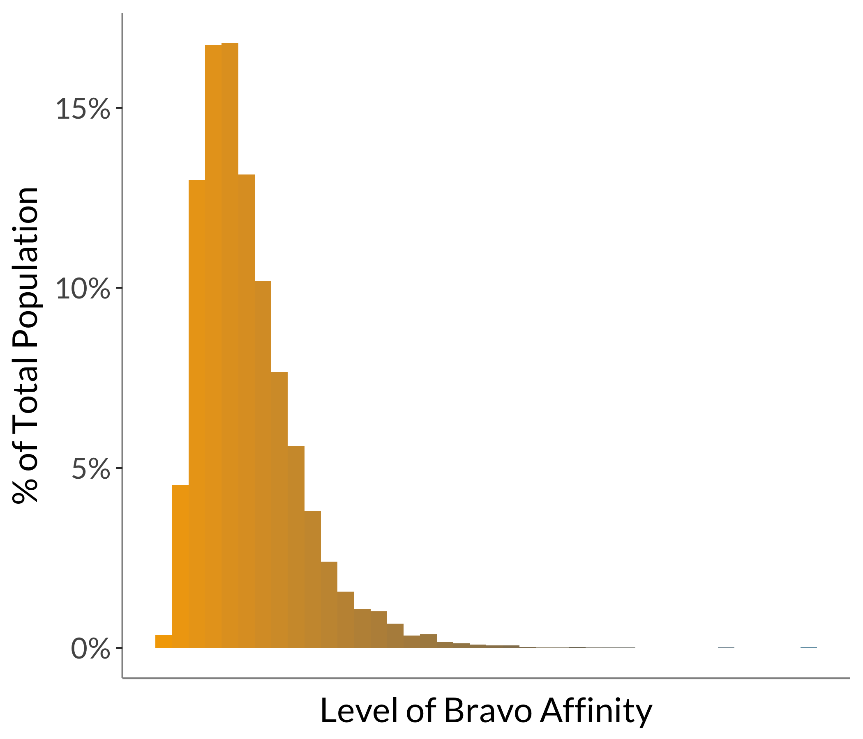
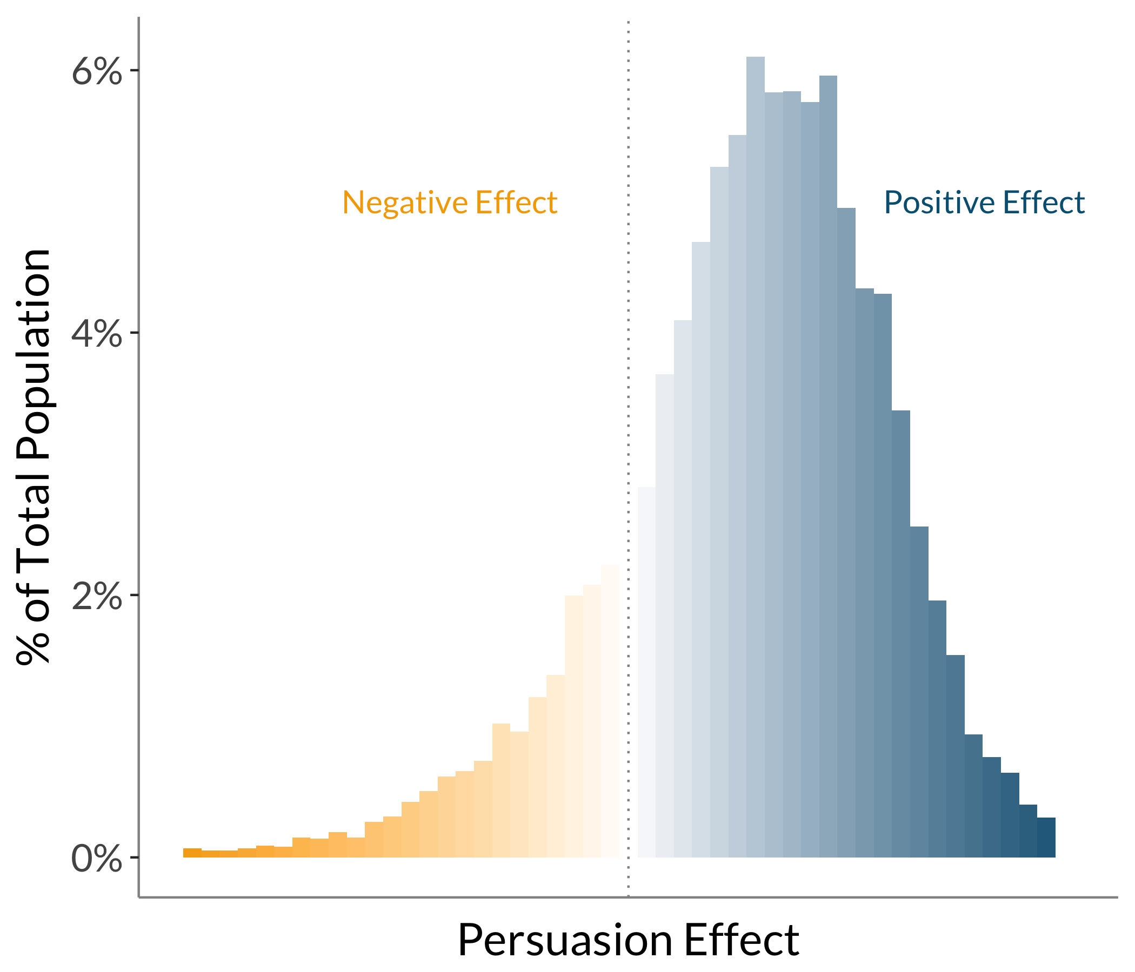
We created two meaningful metrics about support for the brand and likelihood to be persuaded by the promo

Slide 55
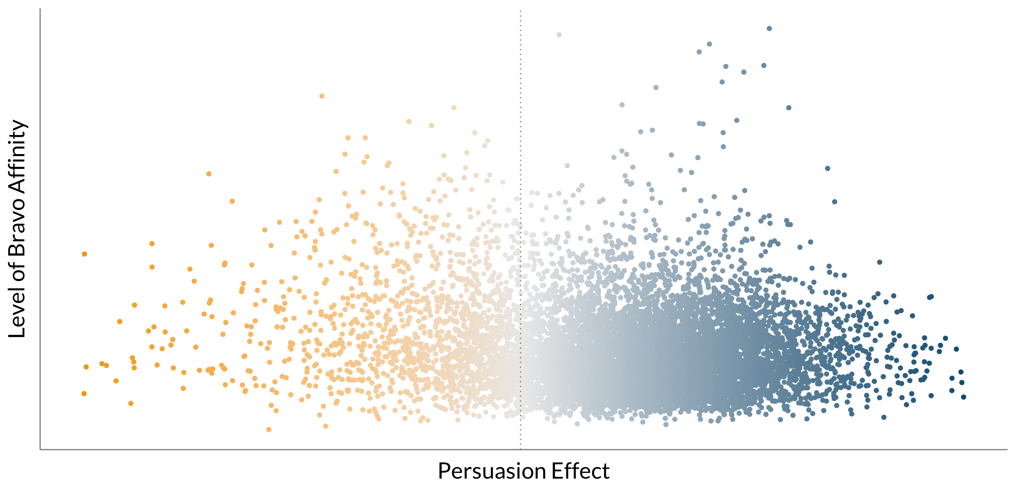
We combined the persuasion scores and our Bravo affinity scores to understand how to isolate “swing viewers”
Each Dot Is a
Person

Slide 56
We combined the persuasion scores and our Bravo affinity scores to understand how to isolate “swing viewers”
These People Will Likely Tune In Anyways Because of their High Support

Slide 57
We combined the persuasion scores and our Bravo affinity scores to understand how to isolate “swing viewers”
These People Won’t Watch No Matter What

Slide 58
We combined the persuasion scores and our Bravo affinity scores to understand how to isolate “swing viewers”
Bravo’s Swing Viewers:
A Casual but Persuadable Group of 22 Million Adults

Slide 59
Case Study II: Persuasion in the 2016 Election Cycle

Slide 60
Political Persuasion in 2016
In early 2016, we conducted a randomized controlled message test for a client using tens of thousands of responses in 14 states around the country.
We tested 3 messages: “women’s health”, “the future of Medicaid and Social Security”, and “tax cuts for the wealthy”.
We averaged the persuasion scores from “the future of Medicaid/Social Security” and “tax cuts for the wealthy” messages for a general “economy persuasion score”. We averaged all three scores to create a “generic persuasion score”.
In August (8 months later), we conducted a follow-up randomized, controlled video ad test in Pennsylvania, which allowed us to validate these persuadable segments.

Slide 61
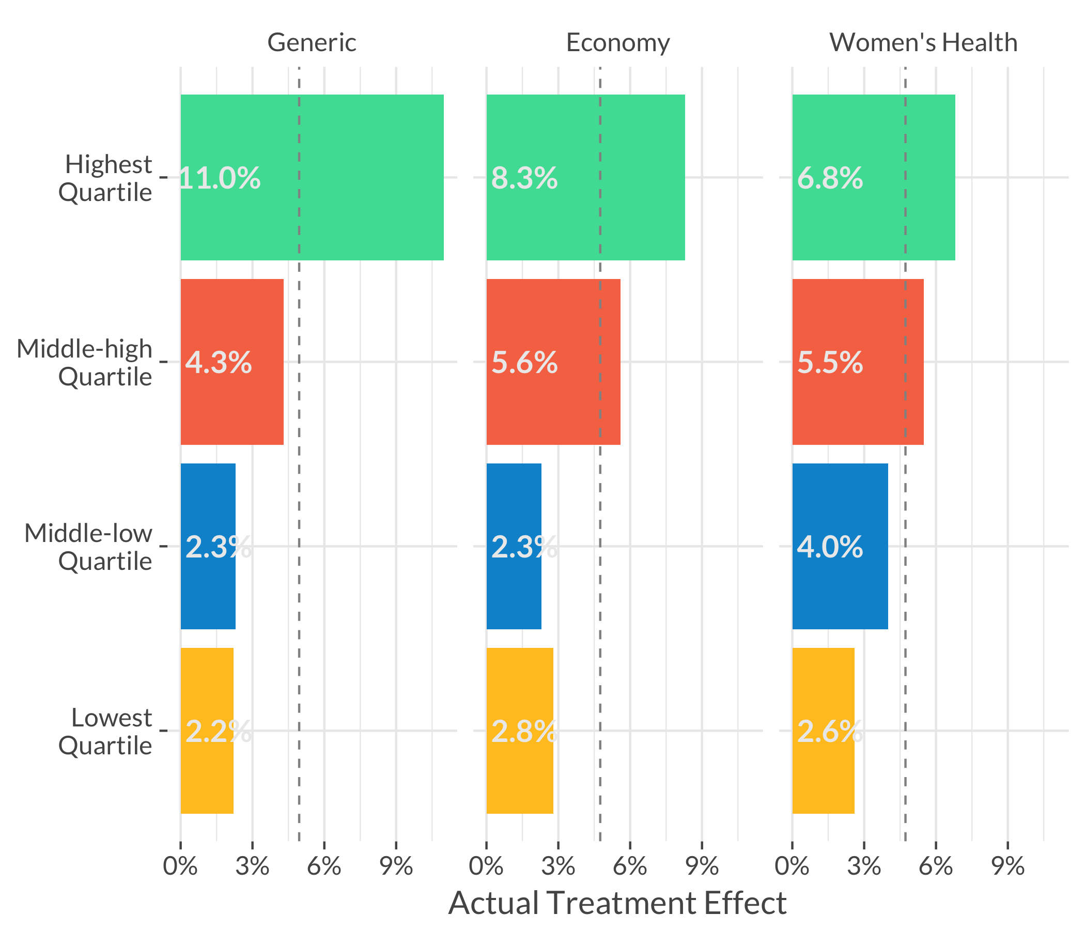
Remarkable result: our persuasion scores reliably predicted the movement of opinion 8 months later in a completely different context.
The top quartile of people that the model predicted to be most persuadable moved 3x-4x as much as the least persuadable people.
Notes:
Columns are different persuasion universes from the first experiment; bars are treatment effects from the second experiment, averaged across messages in the second experiment.

Slide 62
Case Study III: TV Promotional Ad Effectiveness from Observational Data

Slide 63
TV Ad Effectiveness from Observational Data
With purely observational data on who has seen an advertisement, we don’t have nice randomization like we do in a randomized controlled trial.
Maybe people who saw the advertisement are systematically different than those who didn’t.
It’s possible to use techniques like propensity score matching from the causal inference literature to correct for this.
We construct a matched “synthetic” control group who looks like the treatment group in their viewership behavior but just happened to miss the advertisement that we’re studying.

Slide 64
Observational Study
Propensity Model
Saw Ad
Treatment
Propensity Model
Measure Viewership
Didn’t See Ad
Control
Notes:
Note: we can select our initial universe however we want before doing the treatment/control split. In the TV context we’ll talk about later, we could subset only to people who are aware of your network or program or brand.
In the following, we’ll simplify to just assume that we have one treatment/promo and one control.

Slide 65
Observational Study
Model predicting exposure to the ad
Propensity Model
Saw Ad
Treatment
Propensity Model
Measure Viewership
Didn’t See Ad
Control
Notes:
Note: we can select our initial universe however we want before doing the treatment/control split. In the TV context we’ll talk about later, we could subset only to people who are aware of your network or program or brand.
In the following, we’ll simplify to just assume that we have one treatment/promo and one control.

Slide 66
Observational Study
Discard the observations that are too “different” from the ad viewers
Propensity Model
Saw Ad
Treatment
Propensity Model
Measure Viewership
Didn’t See Ad
Control
Notes:
Note: we can select our initial universe however we want before doing the treatment/control split. In the TV context we’ll talk about later, we could subset only to people who are aware of your network or program or brand.
In the following, we’ll simplify to just assume that we have one treatment/promo and one control.

Slide 67
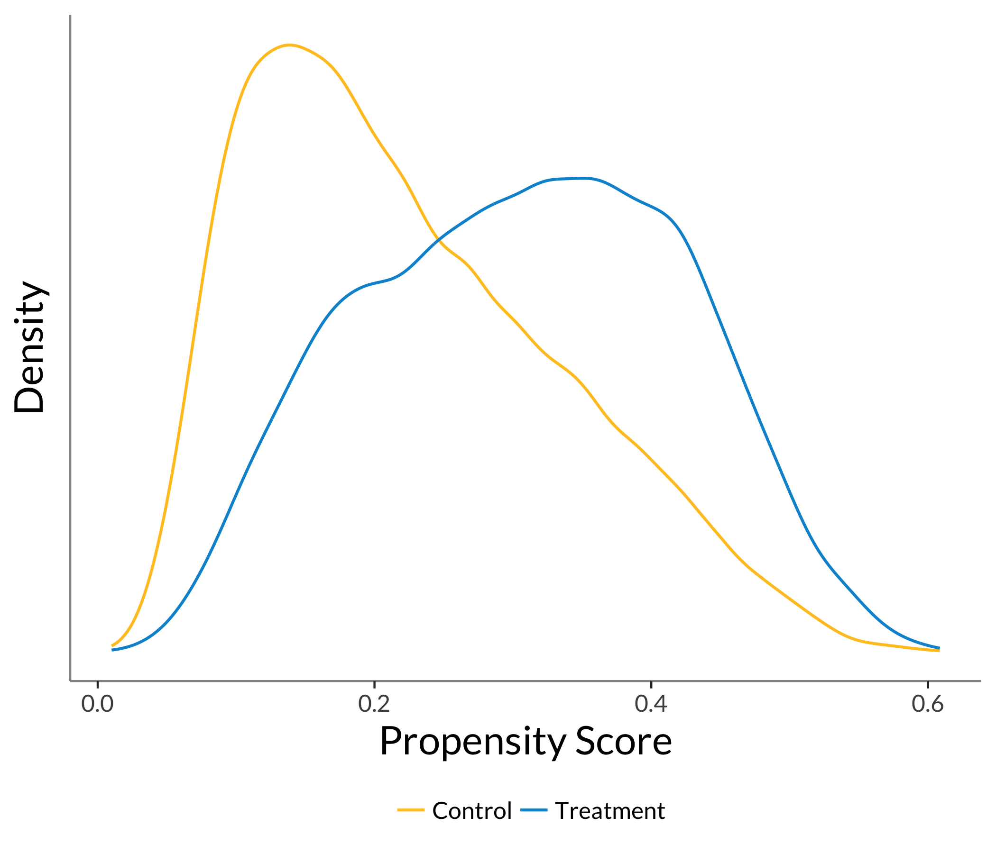
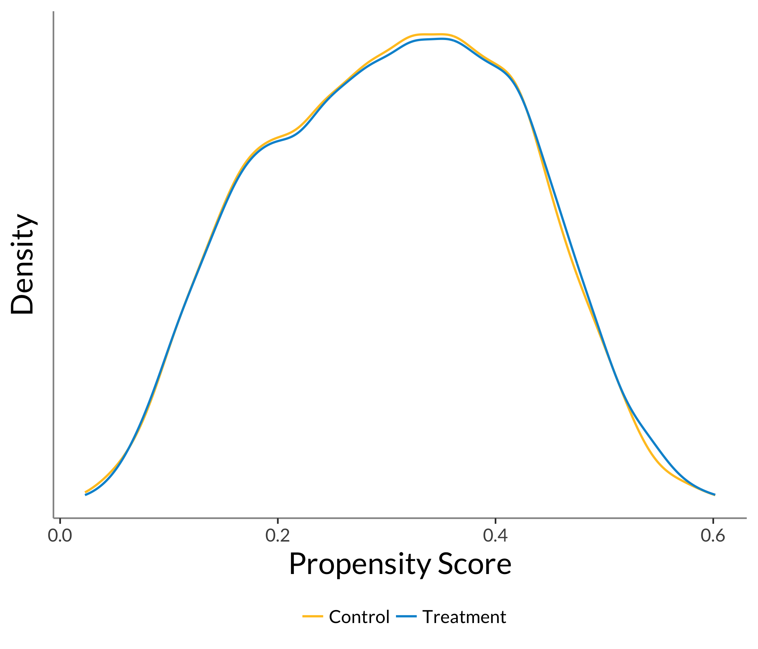
Pre-Match
Post-Match

Slide 68
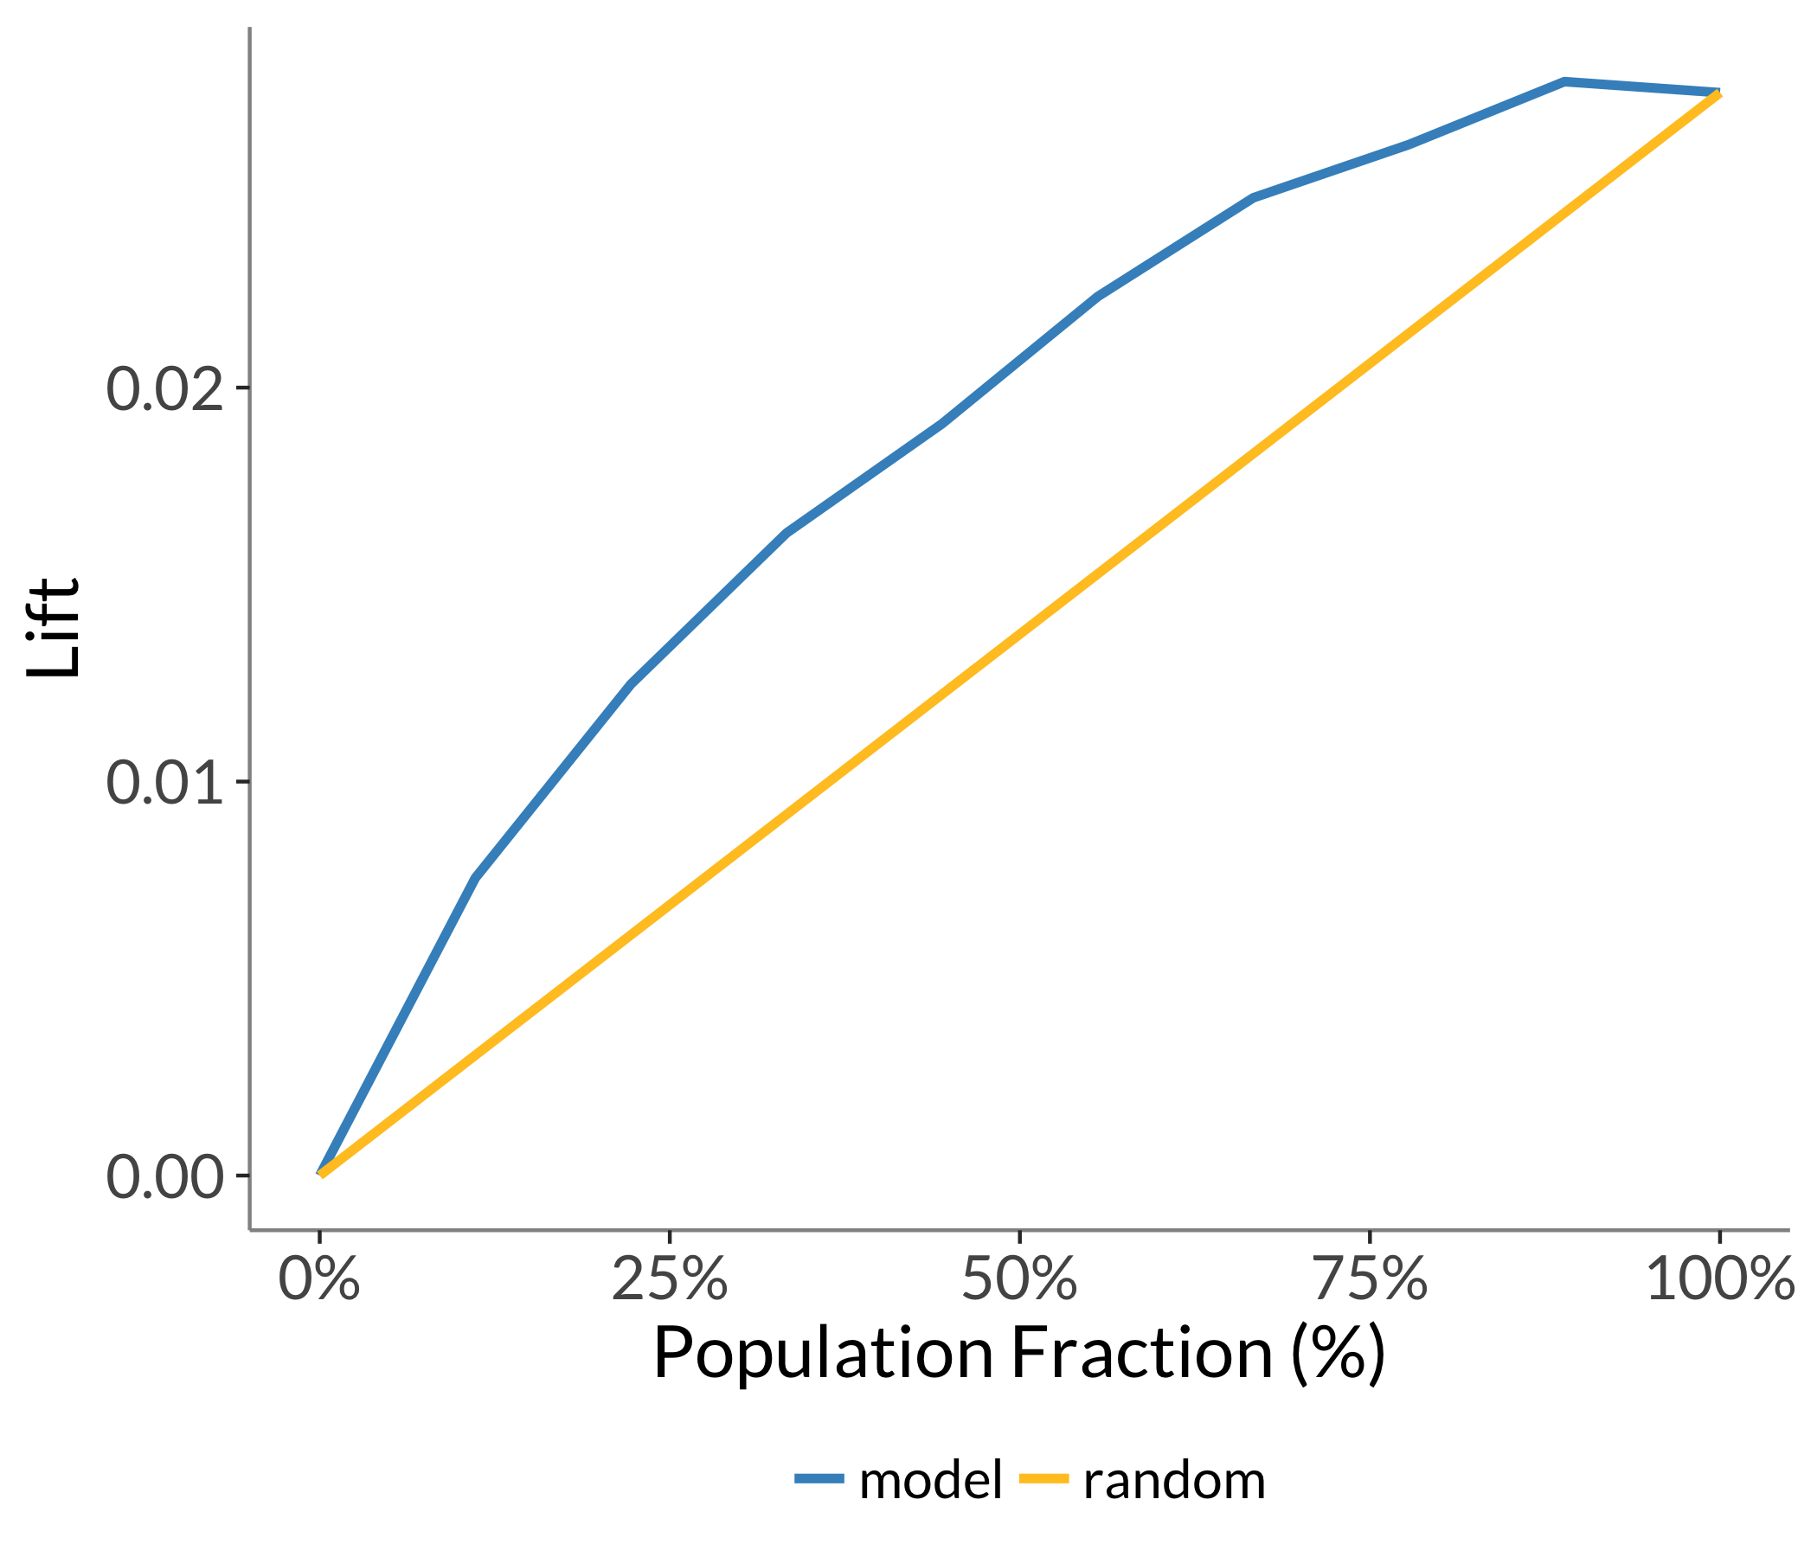
A True Crime Series

Slide 69
A True Crime Series
56, female, 63K/yr

Slide 70
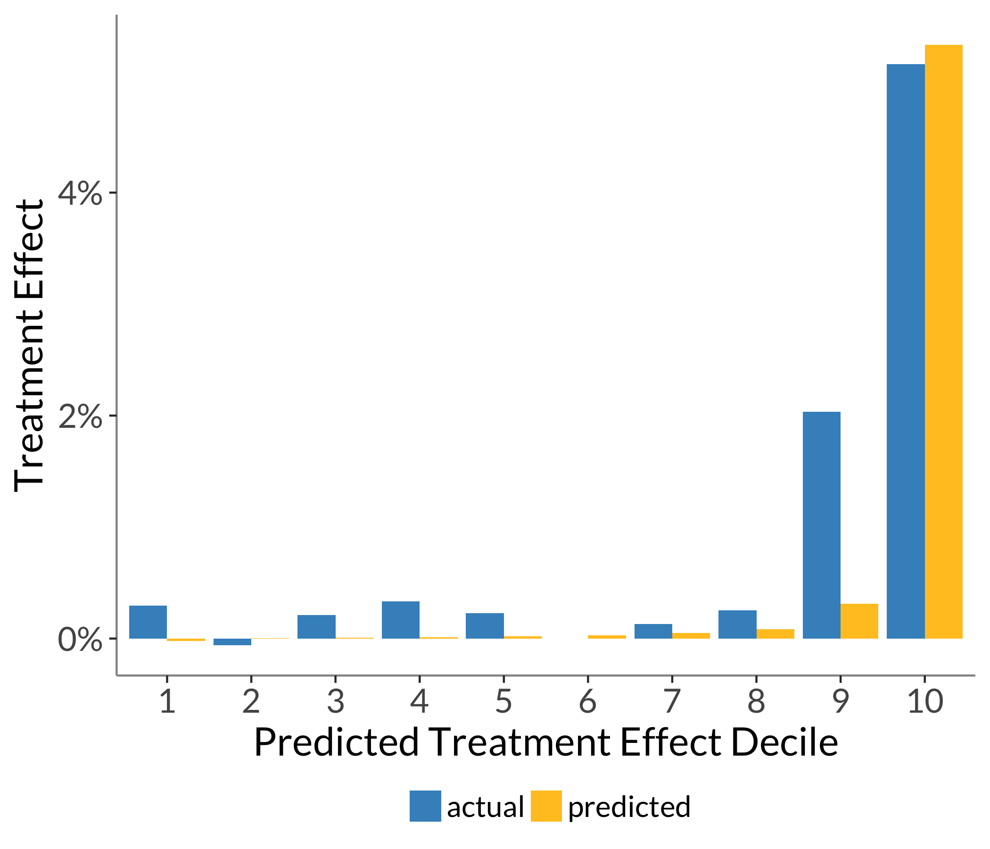
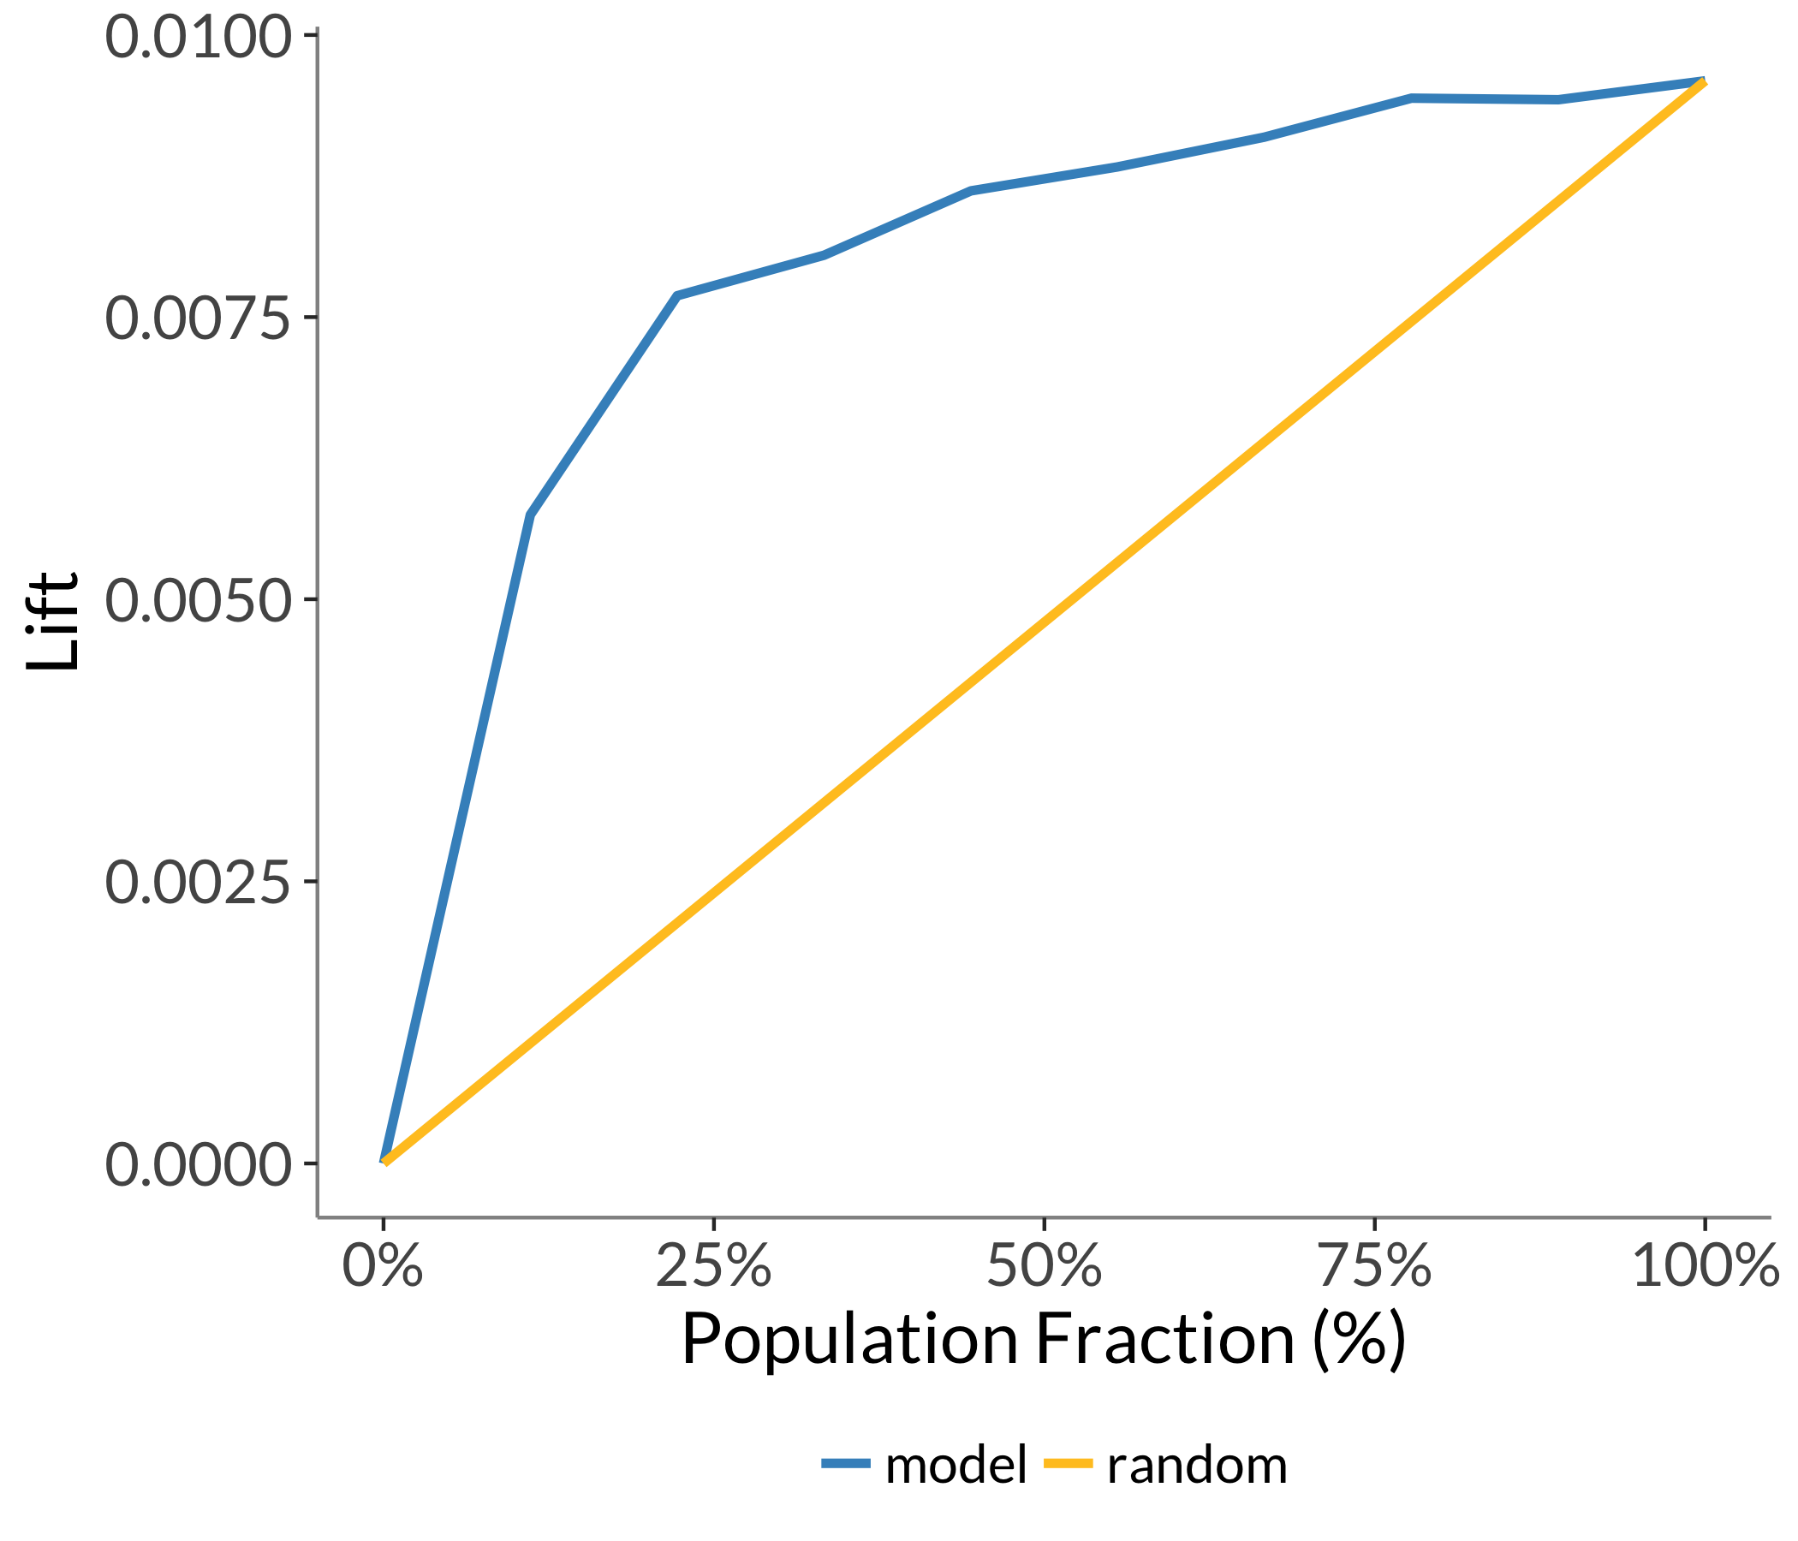
A Family Reality Series

Slide 71
A Family Reality Series
52, Black, from the southwest, 72K/yr, not a cat person

Slide 72
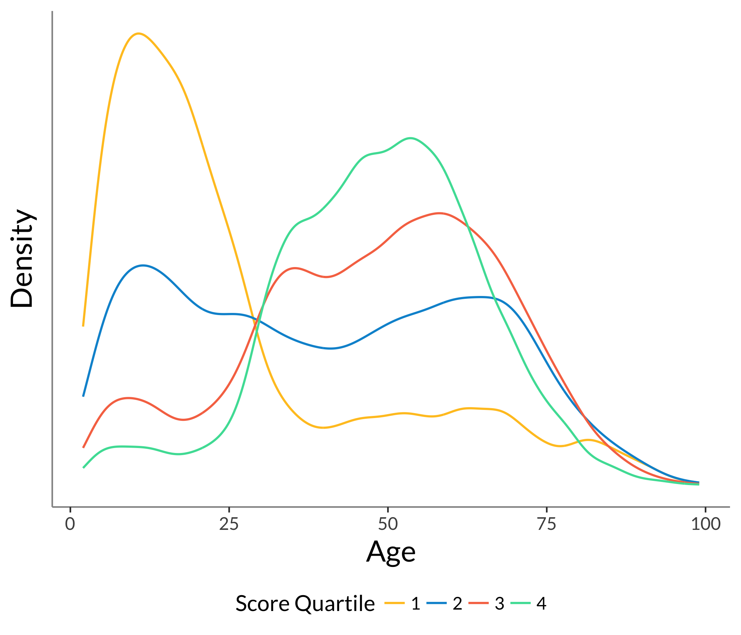
These commercials don’t seem to convince most young people…

Slide 73
Parting Thoughts

Slide 74
Use persuasion modeling when you need to optimally allocate treatments or interventions to achieve some outcome.
Notes:
https://commons.wikimedia.org/wiki/File:The_Thinker_Musee_Rodin.jpg

Slide 75

We’ve open sourced some of our data science tools and plan to release a few of the things we discussed today. Watch GitHub or our blog.
GitHub: github.com/civisanalytics
Website: civisanalytics.com/open-source/
Notes:
https://github.com/logos

Slide 76
Thanks! @MichelangeloDA @wlattner

